Slide 1
Requirement
Specification
13/10/17
Andrea Meier
Anthony Kalbermatten
Cheng-Hsin WUU
Deniz Sarici

Slide 2


1
Inspiration
2
Product Overview
CONTENTS
3
Functionality
4
Non-Functional Requirements

Slide 3

1
Inspiration
Inspiration
Idea: Our program should be built at the example of Emmet
Implementation: command line as a GUI.
Difficulties
Solution
Functions for change and deletion are needed.
Navigation in the HTML is difficult.
Use of EiffelStudio as a GUI.
Notes:
更多作品请搜索: http://dwz.cn/Wu2UP

Slide 4
2
Product Overview
-
HTML Generator Library
(.h file)
Programming File
(main.e)
Input Data
(Folder with different data types)
Output Data
(.html file)
Notes:
更多作品请搜索: http://dwz.cn/Wu2UP
4

Slide 5



2
Product Overview
User characteristics
The user knows how to handle EiffelStudio and our library’s
vocabulary and has no prior knowledge of HTML.
Assumptions
Restrictions
-Generate the file solely through our generator.
-no head or body tag in the snippet
File compiled at the end, no WYSWYG included.
Notes:
更多作品请搜索: http://dwz.cn/Wu2UP
5

Slide 6
3
Functionality
Data I/O
HTML Structure
Input: class with data members corresponding to different data types
Output: output .e & .html file
Default mode: doctype + head + body
Other modes: frame, customized template
Others
High Priority: Style, Paragraph, Image, Audio, Video, Link, Table, List, Snippet Insertion
Low Priority: From& Input, Meta Info, Map, Button, Header & Footer
Notes:
更多作品请搜索: http://dwz.cn/Wu2UP

Slide 7
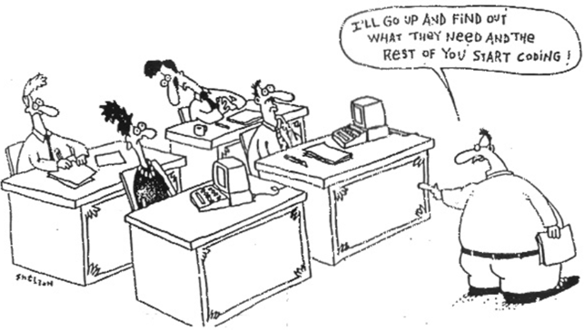
4
Non-Functional Requirements
Reliability & Performance
Reliability
EiffelStudio, error fixing time
Performance
Time to generate output
Storage size
Maintainability
Markup validation (W3C validator)
Class libraries not limited to HTML
Design Constraints
Imposed by Eiffel
Programming language
Operating system
Hardware requirements

Slide 8
THANKS
Have a Nice Day : D

